Slide 1
The confidence of elijah
Sunday Service 17 Mar 2019
Cecil Ang

Slide 2
1 Kings 17:1-5 ESV
¹ Now Elijah the Tishbite, of Tishbe in Gilead, said to Ahab, “As the Lord, the God of Israel, lives, before whom I stand, there shall be neither dew nor rain these years, except by my word.” ² And the word of the Lord came to him: ³ “Depart from here and turn eastward and hide yourself by the brook Cherith, which is east of the Jordan. ⁴ You shall drink from the brook, and I have commanded the ravens to feed you there.” ⁵ So he went and did according to the word of the Lord. He went and lived by the brook Cherith that is east of the Jordan.

Slide 3
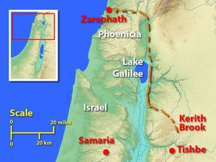
1 Kings 17:6-9 ESV
⁶ And the ravens brought him bread and meat in the morning, and bread and meat in the evening, and he drank from the brook. ⁷ And after a while the brook dried up, because there was no rain in the land. ⁸ Then the word of the Lord came to him, ⁹ “Arise, go to Zarephath, which belongs to Sidon, and dwell there. Behold, I have commanded a widow there to feed you.”

Slide 4
1 Kings 17:19-22 ESV
¹⁹ And he said to her, “Give me your son.” And he took him from her arms and carried him up into the upper chamber where he lodged, and laid him on his own bed. ²⁰ And he cried to the Lord, “O Lord my God, have you brought calamity even upon the widow with whom I sojourn, by killing her son?” ²¹ Then he stretched himself upon the child three times and cried to the Lord, “O Lord my God, let this child's life come into him again.” ²² And the Lord listened to the voice of Elijah. And the life of the child came into him again, and he revived.

Slide 5
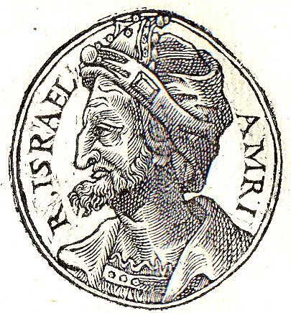
Background
Omri, 6th king of Israel
Encouraged Baal worship
Established a marriage alliance with the King of Sidon, Phoenicia: his son Ahab married Jezebel, priestess of Baal
Israel’s backsliding reached its peak under Ahab’s rule

Slide 6
Background
He erected an altar for Baal in the house of Baal, which he built in Samaria. And Ahab made an Asherah. Ahab did more to provoke the Lord, the God of Israel, to anger than all the kings of Israel who were before him. 1 Kings 16:32-33 ESV

Slide 7
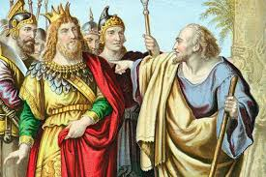
Elijah - “My God is Yahweh”
Elijah speaks for God (1 Kg 17:1)
Elijah hears & obeys God (1 Kg 17:2-5)
Elijah talks to God (1 Kg 17:20-21)

Slide 8
1. Elijah speaks for God (1 Kg 17:1)
Baal was the Canaanite god responsible for rain, thunder, lightning, and dew (fertility & agriculture)
God judged Israel & its gods
For I will pass through the land of Egypt that night, and I will strike all the firstborn in the land of Egypt, both man and beast; and on all the gods of Egypt I will execute judgments: I am the Lord. Ex 12:12 ESV

Slide 9
Judgment on the gods of Egypt
Nile turned into blood –Khnum guardian of the Nile
Frogs - Heqet (hay-qut) was the Egyptian goddess of birth and fertility
Boils - Isis was the great goddess of health, medicine, and healing
Death of the 1st born son - Pharoah was viewed as a “living god”, as was his son.

Slide 10
Lessons for us today
But I am afraid that as the serpent deceived Eve by his cunning, your thoughts will be led astray from a sincere and pure devotion to Christ. 2 Cor 11:3 ESV
“All the counsel you have received has only worn you out! Let your astrologers come forward, those stargazers who make predictions month by month, let them save you from what is coming upon you.” Is 47:13 NIV

Slide 11
Lessons for us today
“But as for you who forsake the Lord and forget my holy mountain, who spread a table for Fortune and fill bowls of mixed wine for Destiny, I will destine you for the sword, and all of you will fall in the slaughter; for I called but you did not answer, I spoke but you did not listen. You did evil in my sight and chose what displeases me.” Is 65:11-12 NIV
“Because he who is blessed in the earth will be blessed by the God of truth …” Is 65:16 NASB

Slide 12
Lessons for us today
⁵ “Behold, I will send you Elijah the prophet before the great and awesome day of the Lord comes. ⁶ And he will turn the hearts of fathers to their children and the hearts of children to their fathers, lest I come and strike the land with a decree of utter destruction.” Mal 4:5-6 ESV

Slide 13
2. Elijah hears & obeys God
To hide himself by the brook of Cherith (v 3); God commanded the ravens to feed him
To dwell in Zarephath (v 9); God commanded a widow to feed him
Walk of Faith: to hear and obey God on a consistent basis

Slide 14
2. Elijah hears & obeys God
¹¹ And as she was going to bring it, he called to her and said, “Bring me a morsel of bread in your hand.” ¹² And she said, “As the Lord your God lives, I have nothing baked, only a handful of flour in a jar and a little oil in a jug. And now I am gathering a couple of sticks that I may go in and prepare it for myself and my son, that we may eat it and die.” ¹³ And Elijah said to her, “Do not fear; go and do as you have said. But first make me a little cake of it and bring it to me, and afterward make something for yourself and your son.

Slide 15
2. Elijah hears & obeys God
¹⁴ For thus says the Lord, the God of Israel, ‘The jar of flour shall not be spent, and the jug of oil shall not be empty, until the day that the Lord sends rain upon the earth.’” ¹⁵ And she went and did as Elijah said. And she and he and her household ate for many days. ¹⁶ The jar of flour was not spent, neither did the jug of oil become empty, according to the word of the Lord that he spoke by Elijah. 1 Kgs 17:11-16

Slide 16
2. Elijah hears and obeys God
Through Elijah, the widow of Zarephath was encouraged to walk by faith as well.
God took care of His servant and a widow & her son (Ps 68:5).
Elijah lodged in the very heart of Baal’s territory where Jezebel (Sidon) came from and was protected by God.

Slide 17
Lessons for us today
Do not love the world or the things in the world. If anyone loves the world, the love of the Father is not in him. For all that is in the world—the lust of the flesh, the lust of the eyes, and the pride of life—is not of the Father but is of the world. And the world is passing away, and the lust of it; but he who does the will of God abides forever. 1 Jn 2:15-17 NKJV

Slide 18
Lessons for us today
“But I say, walk by the Spirit, and you will not gratify the desires of the flesh.” Gal 5:16 ESV
“Humble yourselves, therefore, under the mighty hand of God so that at the proper time he may exalt you …” 1 Pet 5:6 ESV

Slide 19
Lessons for us today
¹⁴ He said, “I have been very jealous for the Lord, the God of hosts. For the people of Israel have forsaken your covenant, thrown down your altars, and killed your prophets with the sword, and I, even I only, am left, and they seek my life, to take it away. … ¹⁸ Yet I will leave seven thousand in Israel, all the knees that have not bowed to Baal, and every mouth that has not kissed him.” 1 Kgs 19:14,18 ESV

Slide 20
3. Elijah talks to God
The Lord listened to the voice of Elijah (1 Kg 17:22).
Elijah learned to listen & obey God first.
Elijah was a man with a nature like ours, and he prayed fervently that it might not rain, and for three years and six months it did not rain on the earth. Then he prayed again, and heaven gave rain, and the earth bore its fruit. Jas 5:17-18 ESV

Slide 21
3. Elijah talks to God
⁴¹ And Elijah said to Ahab, “Go up, eat and drink, for there is a sound of the rushing of rain.” ⁴² So Ahab went up to eat and to drink. And Elijah went up to the top of Mount Carmel. And he bowed himself down on the earth and put his face between his knees. ⁴³ And he said to his servant, “Go up now, look toward the sea.” And he went up and looked and said, “There is nothing.” And he said, “Go again,” seven times. ⁴⁴ And at the seventh time he said, “Behold, a little cloud like a man's hand is rising from the sea.” And he said, “Go up, say to Ahab, ‘Prepare your chariot and go down, lest the rain stop you.’” ⁴⁵ And in a little while the heavens grew black with clouds and wind, and there was a great rain. 1 Kgs 18:41-45 ESV

Slide 22
3. Elijah talks to God
Walking by faith means travailing in prayer
till God’s word comes to pass [national crisis]
in unexpected situations for others [widow’s son]
for ourselves; discouragement is a battle many of us would have to face one time or another
“It is enough; now, O Lord, take away my life, for I am no better than my fathers.” 1 Kgs 19:4 ESV

Slide 23
Lessons for us today
Do we talk to God on a regular basis, beyond just saying grace?
Do we share our frustration and disappointment with God?
How often do we persevere on in prayer until the answer comes?

Slide 24
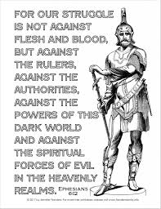
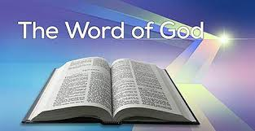
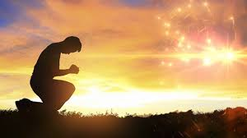
The Confidence of Elijah
OBEY
PRAY
LISTEN
I write to you, young men, because you are strong, and the word of God abides in you, and you have overcome the evil one. 1 Jn 2:14 ESV

